Slide 2
PROPOSED AGENDA
60TH General Membership Meeting
1. Attendance record Reception desk
2. Delivery of Donations Members (Reception desk)
3. Assignation of Teller President
4. Verify Presence of Quorum Teller
5. Approval of the Agenda Members
6. Approval of the Minutes of The Previous Meeting Members
7. Reflections from the President Marilú Baca
8. Treasurer’s Report 2019 Alberto Rosas
9. Presentation of the Board Teller Members 2020-2022
10. General Affairs Members
11. Close Of The Session Teller
12. Cocktail & Hor’s deouvres Attendees

Slide 3
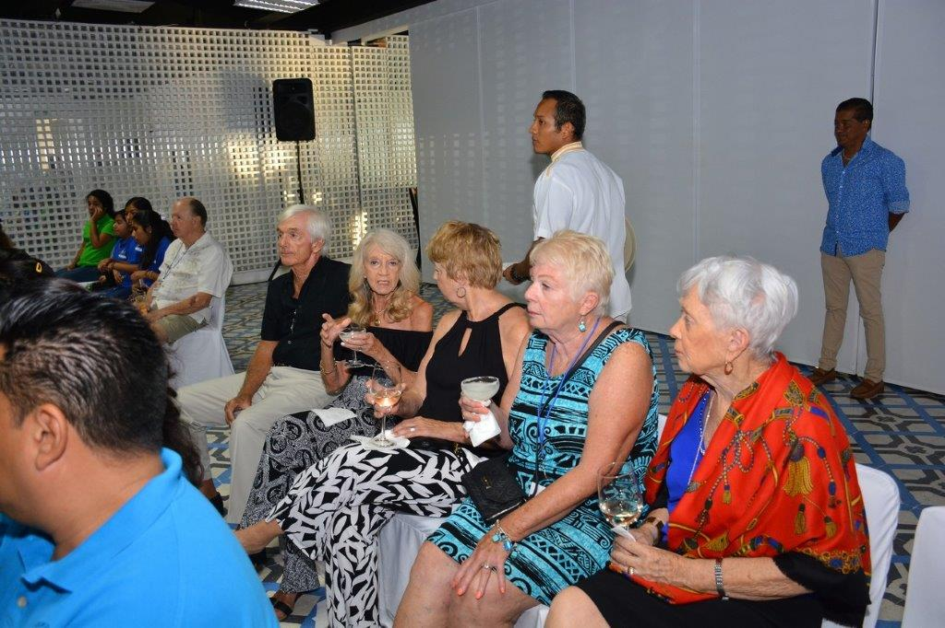
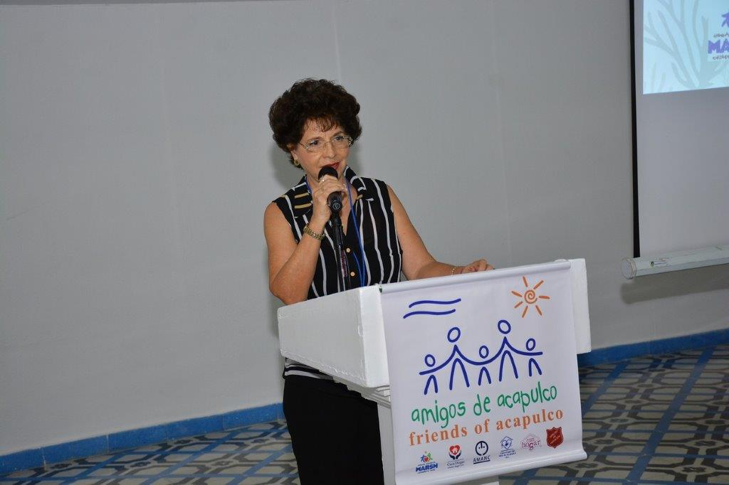
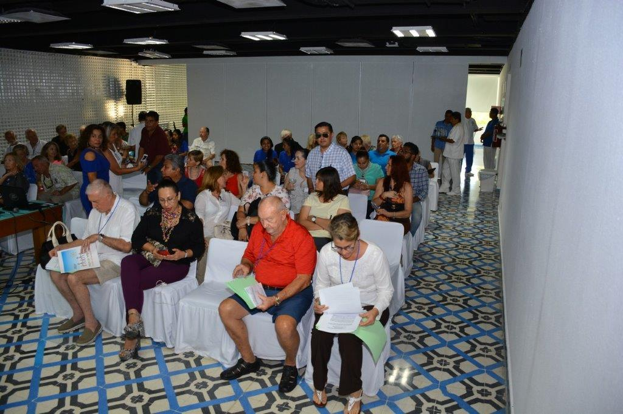
ASSIGNATION OF TELLER

Slide 4
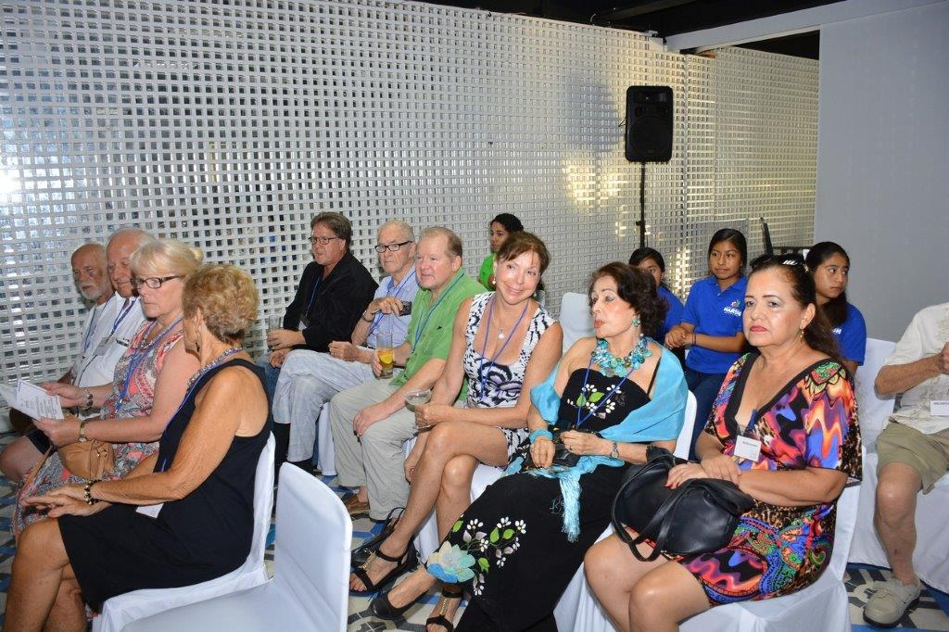
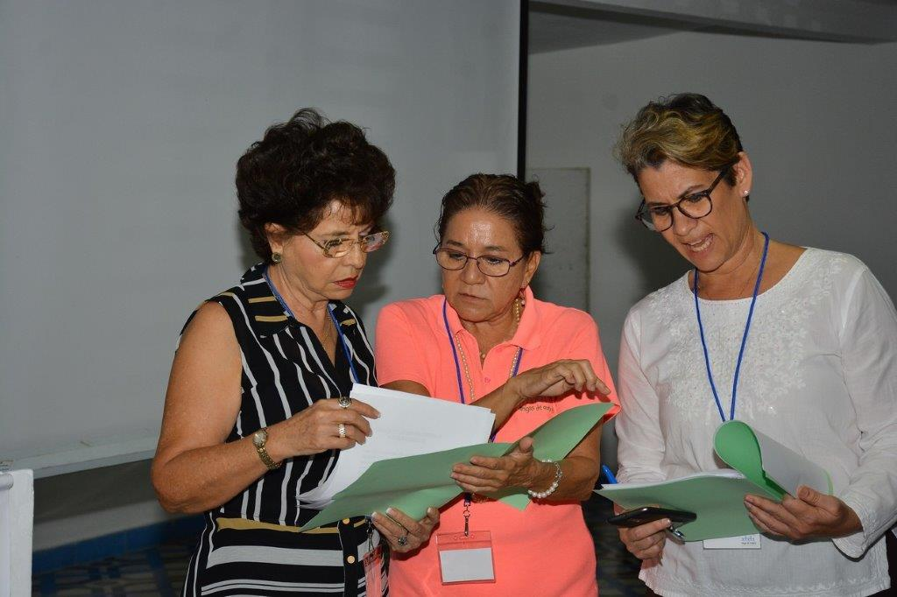
VERIFY PRESENCE OF QUORUM

Slide 5
1. Attendance record Reception desk
2. Delivery of Donations Members (Reception desk)
3. Assignation of Teller President
4. Verify Presence of Quorum Teller
5. Approval of the Agenda Members
6. Approval of the Minutes of The Previous Meeting Members
7. Reflections from the President Marilú Baca
8. Treasurer’s Report 2019 Alberto Rosas
9. Presentation of the Board Teller Members 2020-2022
10. General Affairs Members
11. Close Of The Session Teller
12. Cocktail & Hor’s deouvres Attendees
APPROVAL OF THE AGENDA

Slide 6
APPROVAL OF THE MINUTES
OF THE PREVIOUS MEETING
The Minutes of the General Membership meeting held on January 23rd., 2019 were mailed to all members together with the proxy and the Call for this sixtieth Annual Assembly.

Slide 7
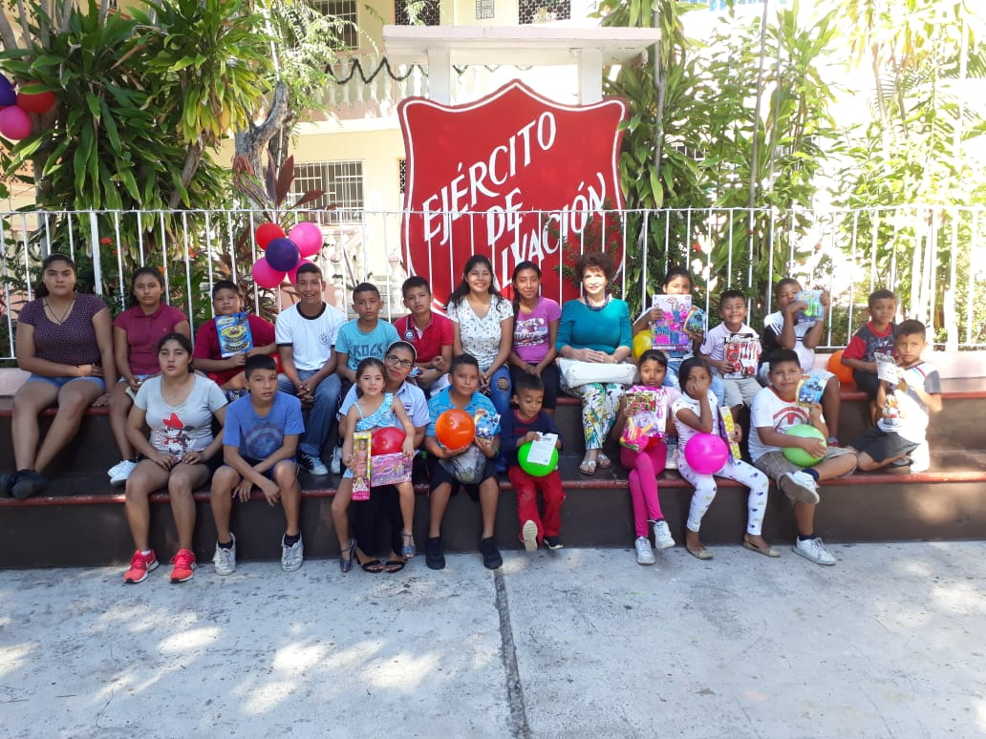
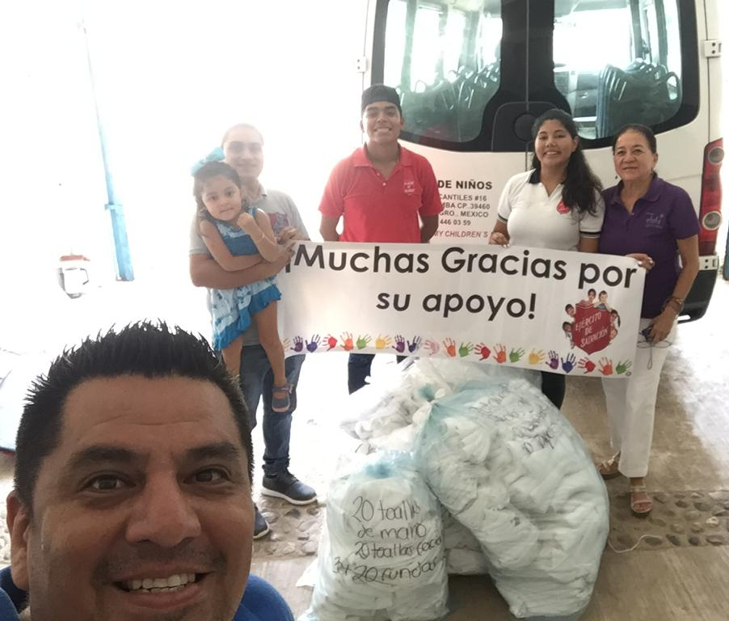

Slide 8
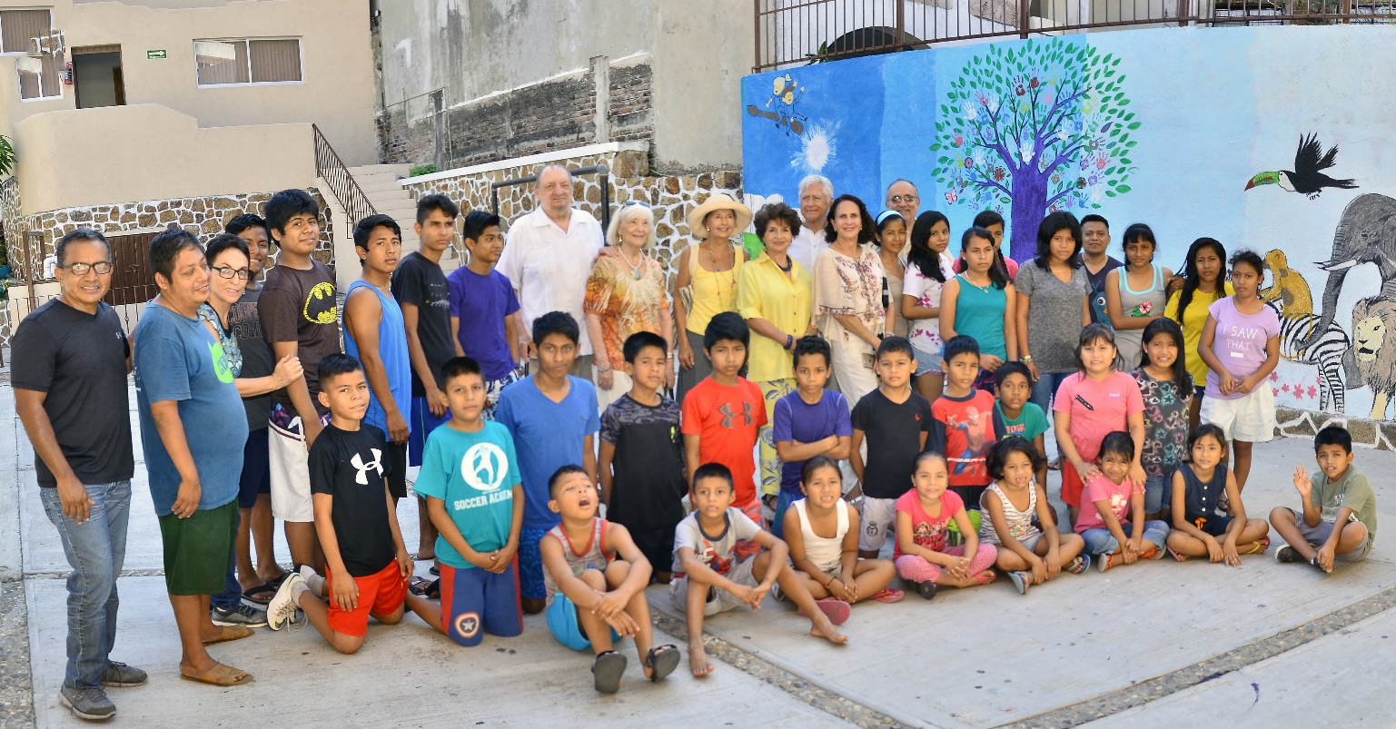
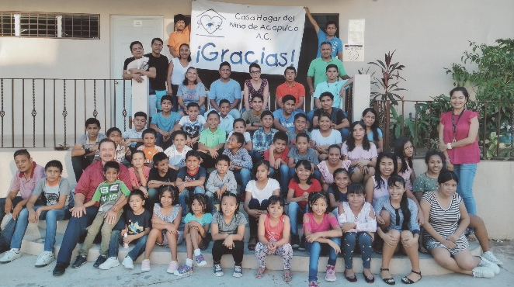
HOGARES

Slide 9
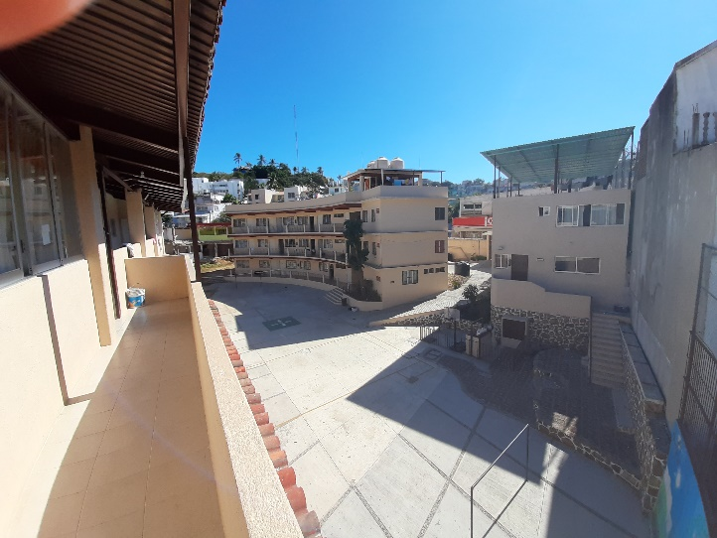
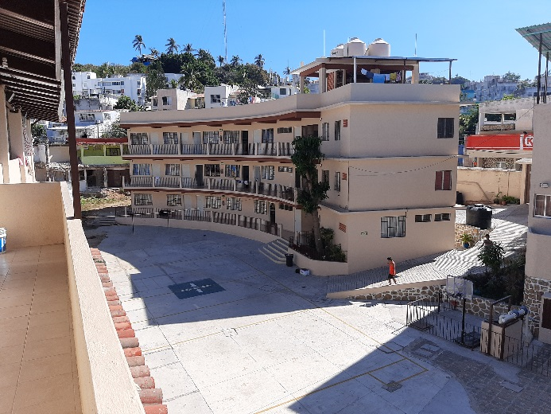
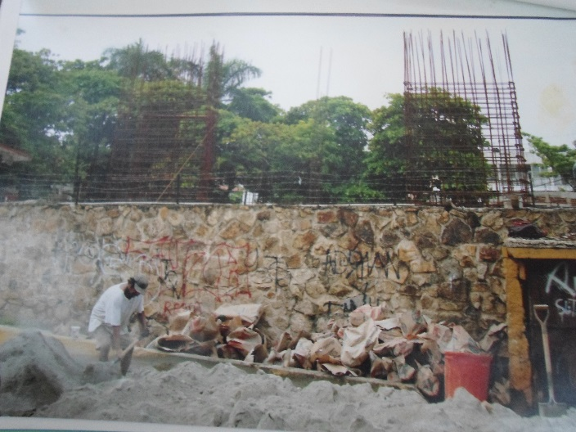
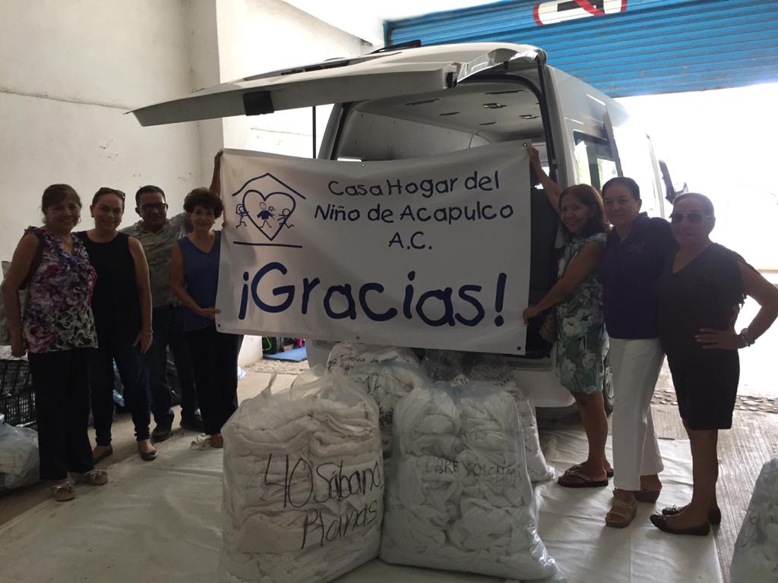

Slide 10
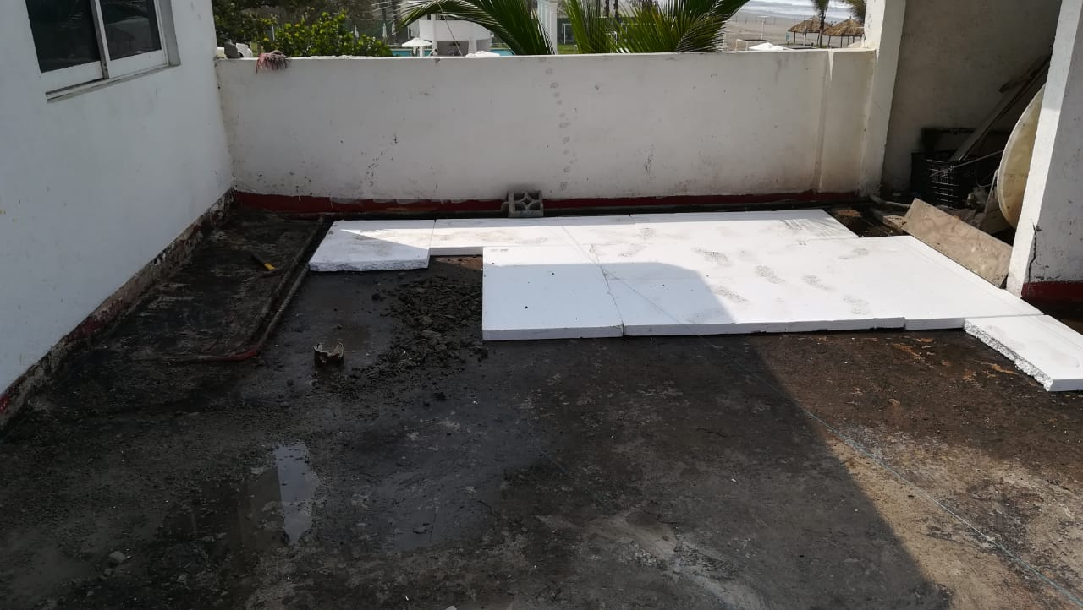
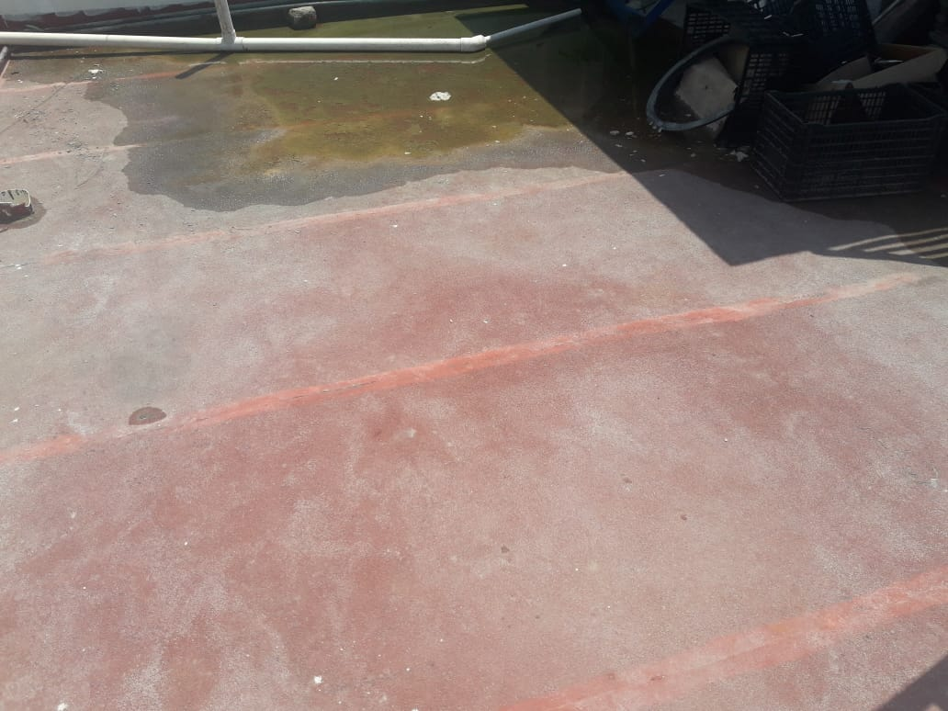
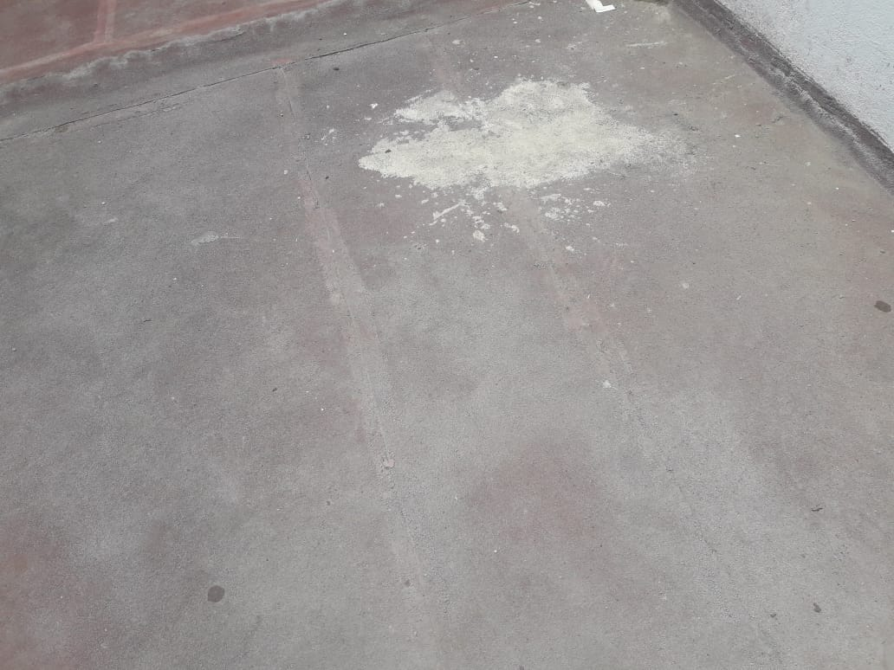
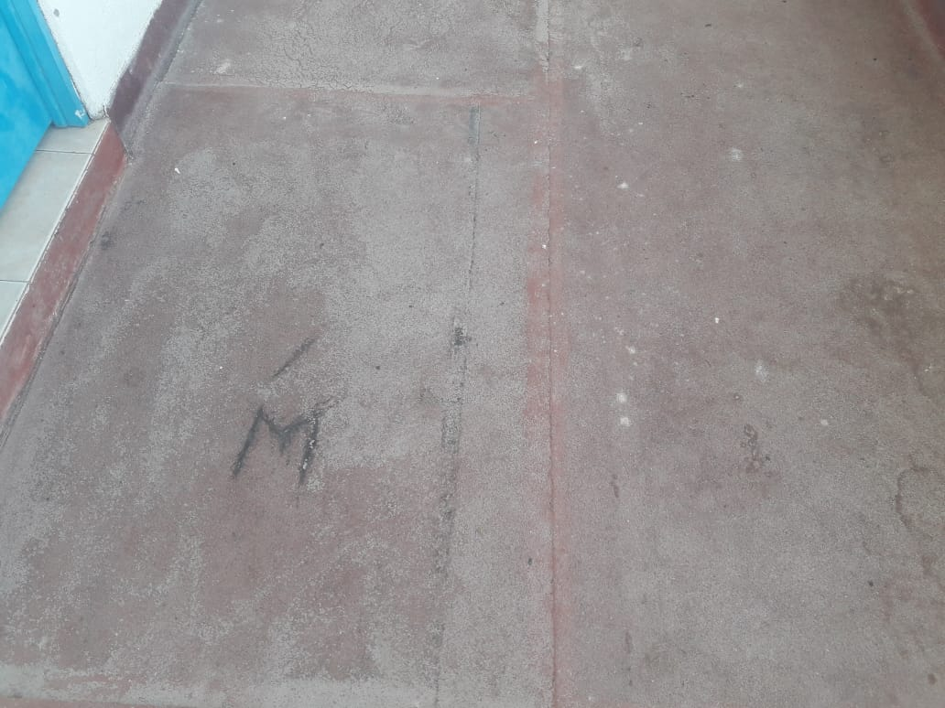
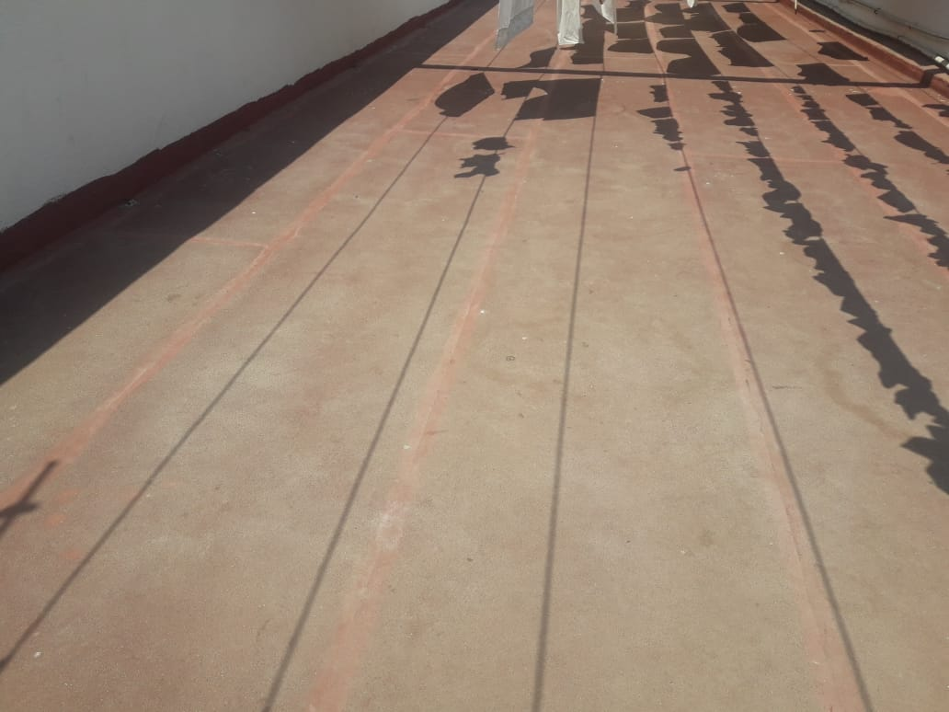

Slide 11
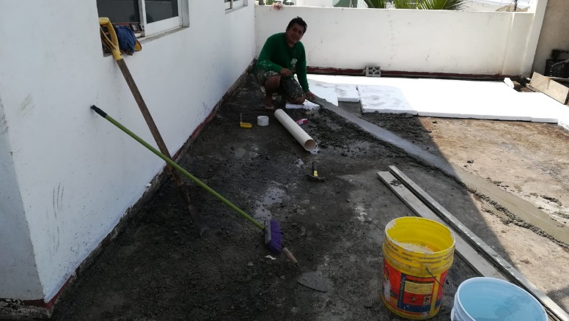
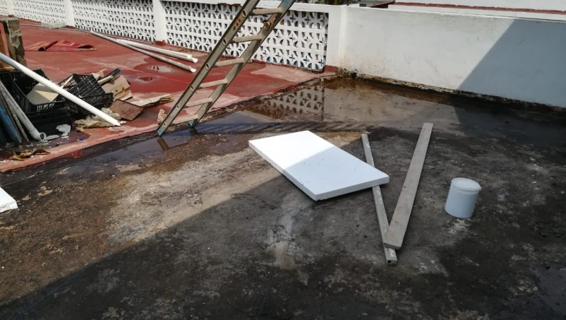
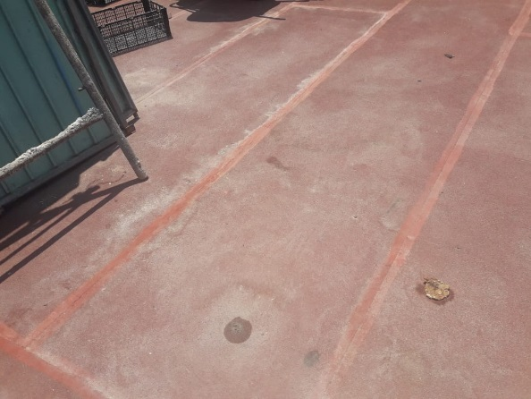
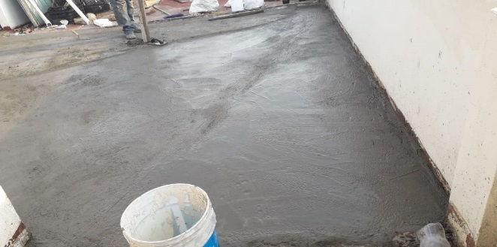
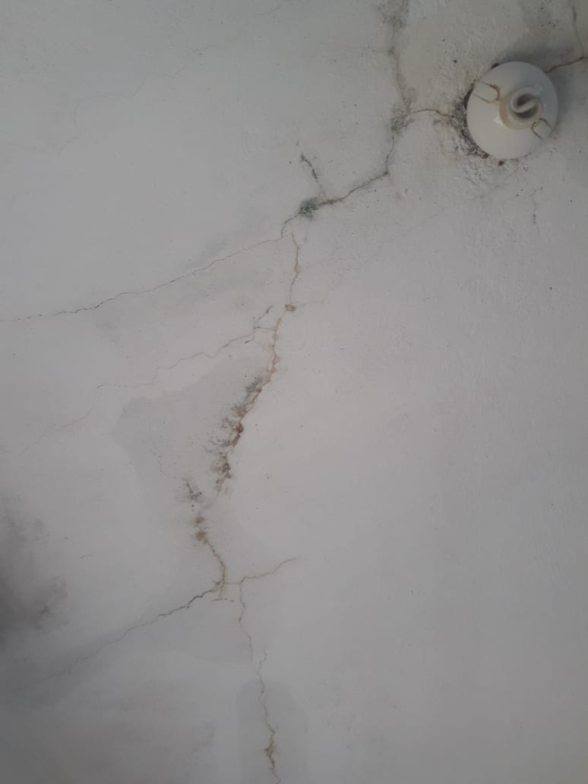
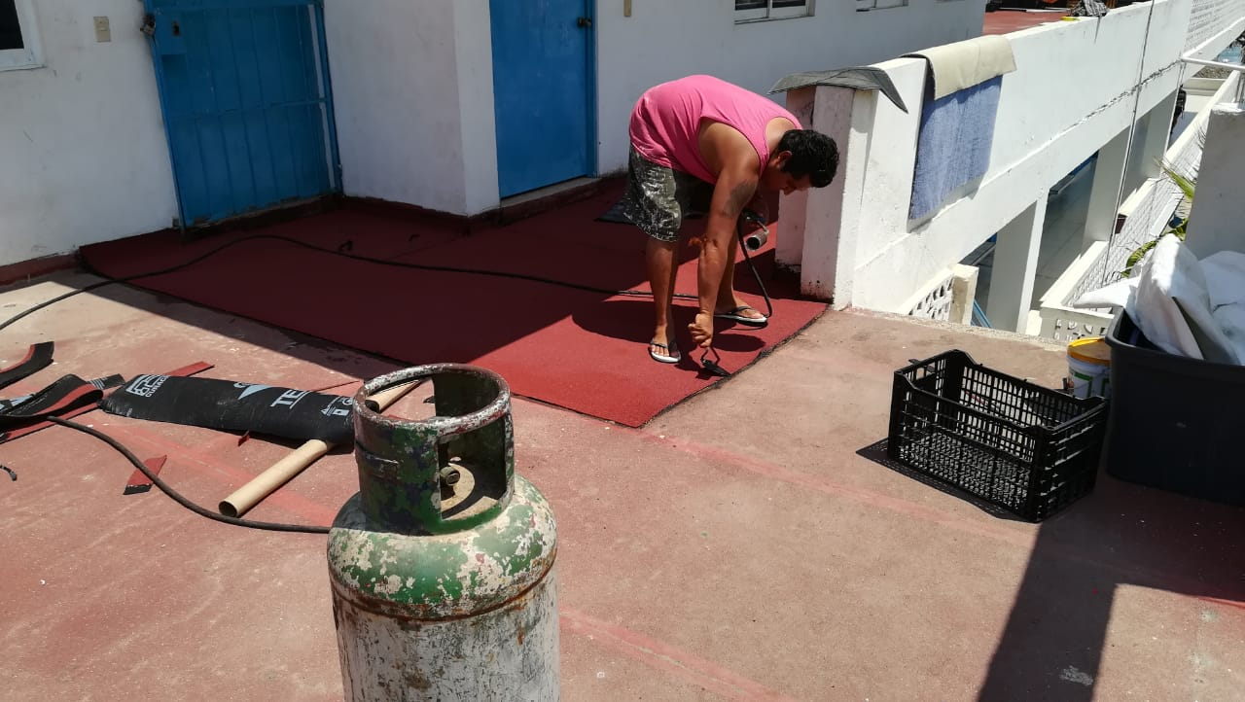
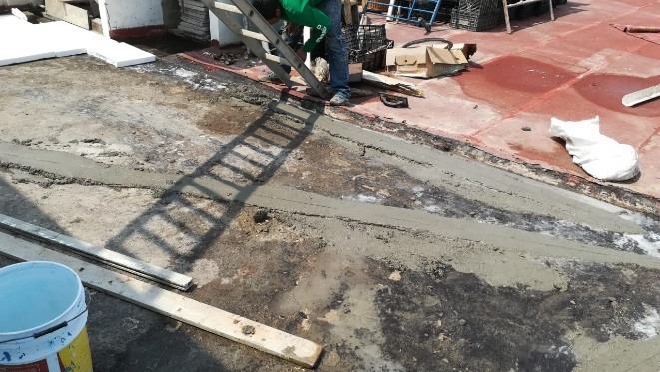
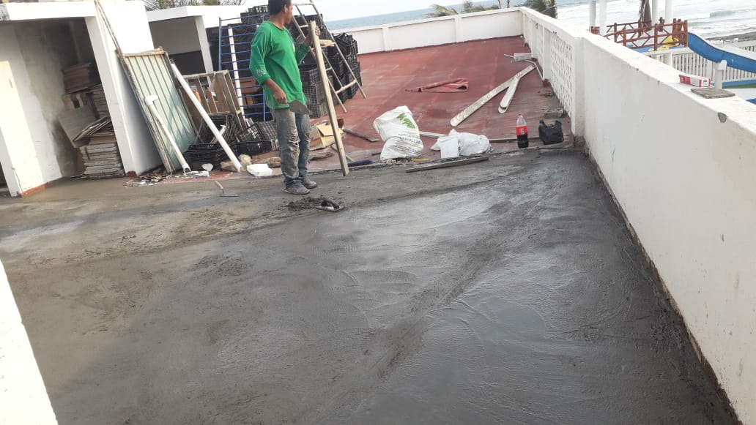
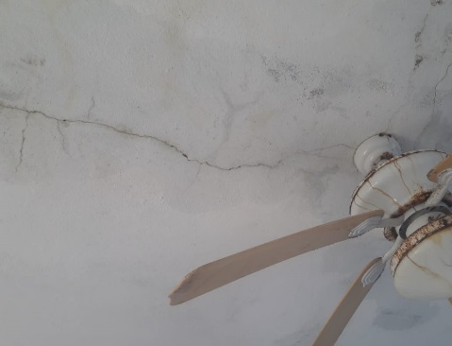
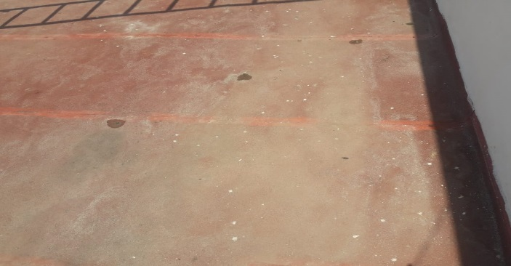

Slide 12
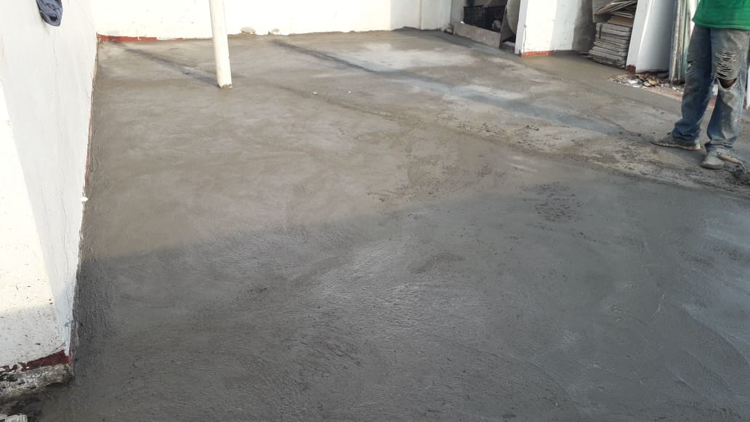
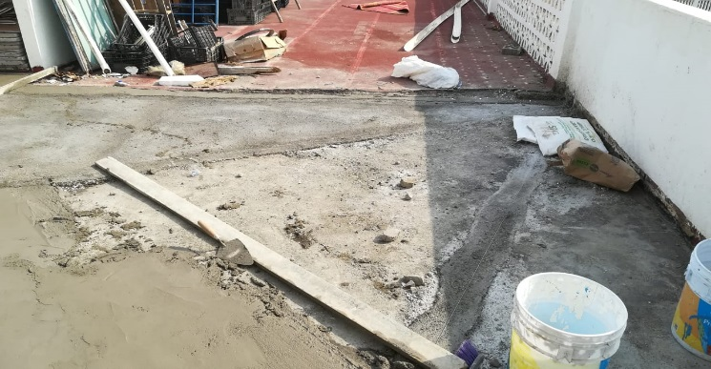
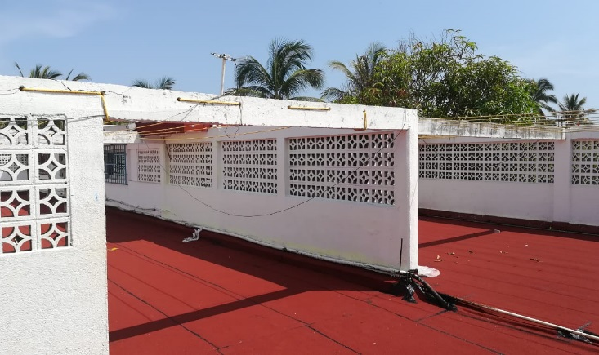
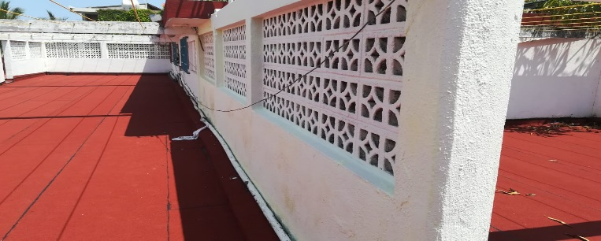
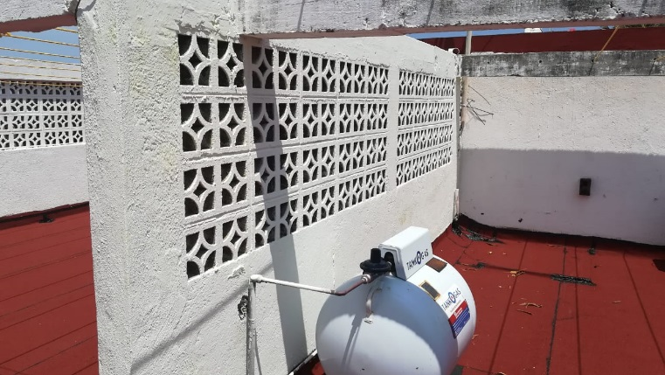
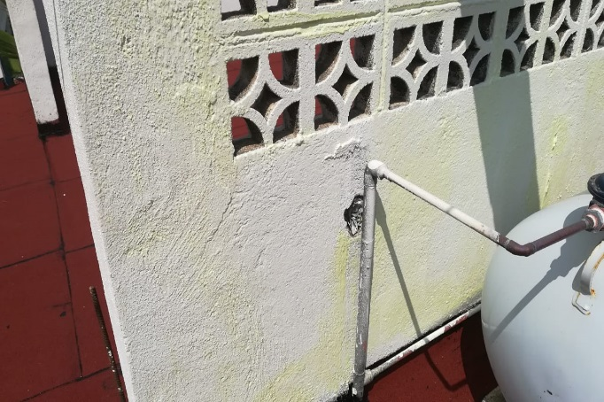
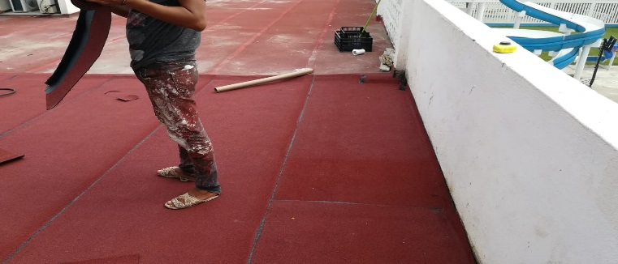
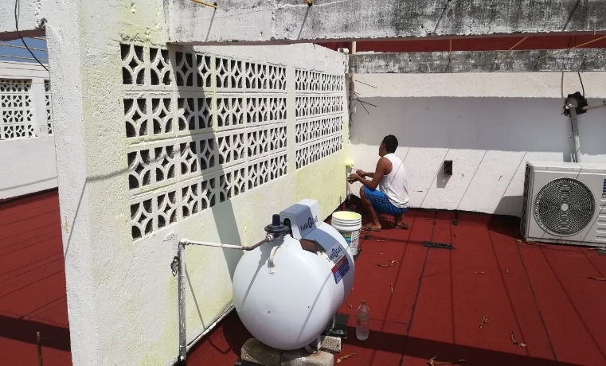
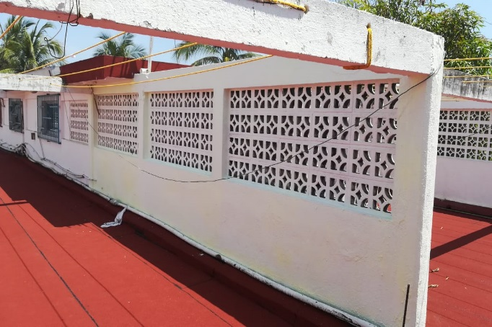
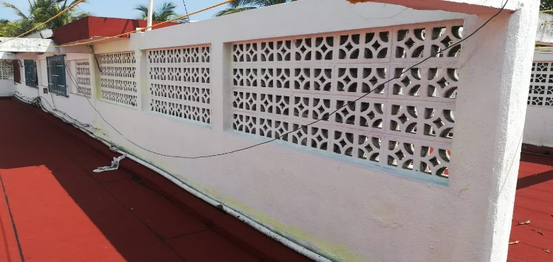

Slide 13
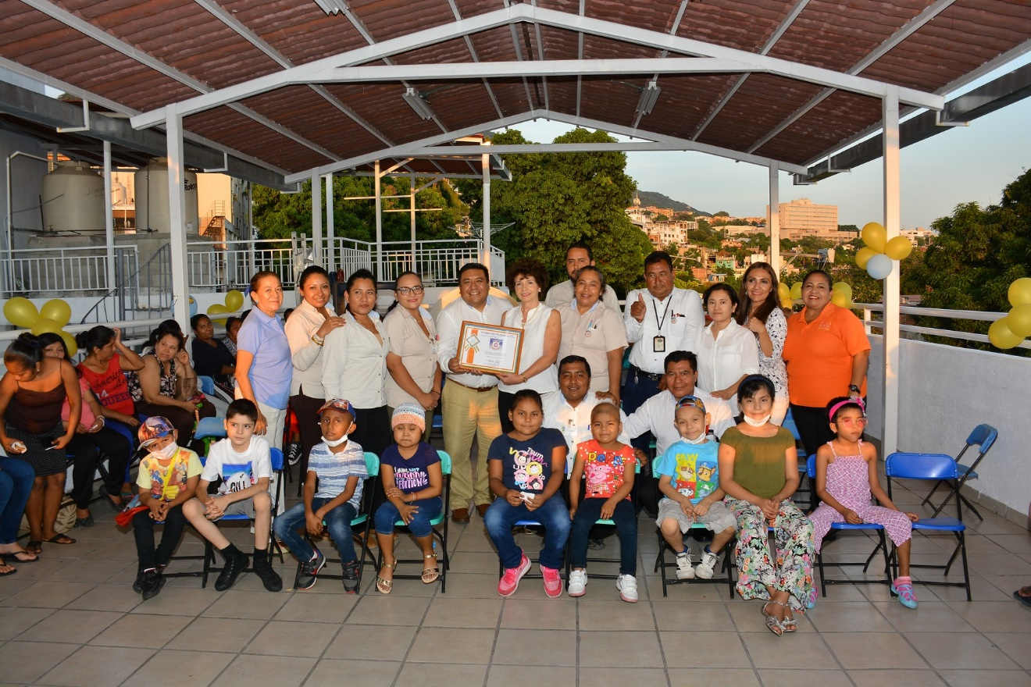

Slide 14
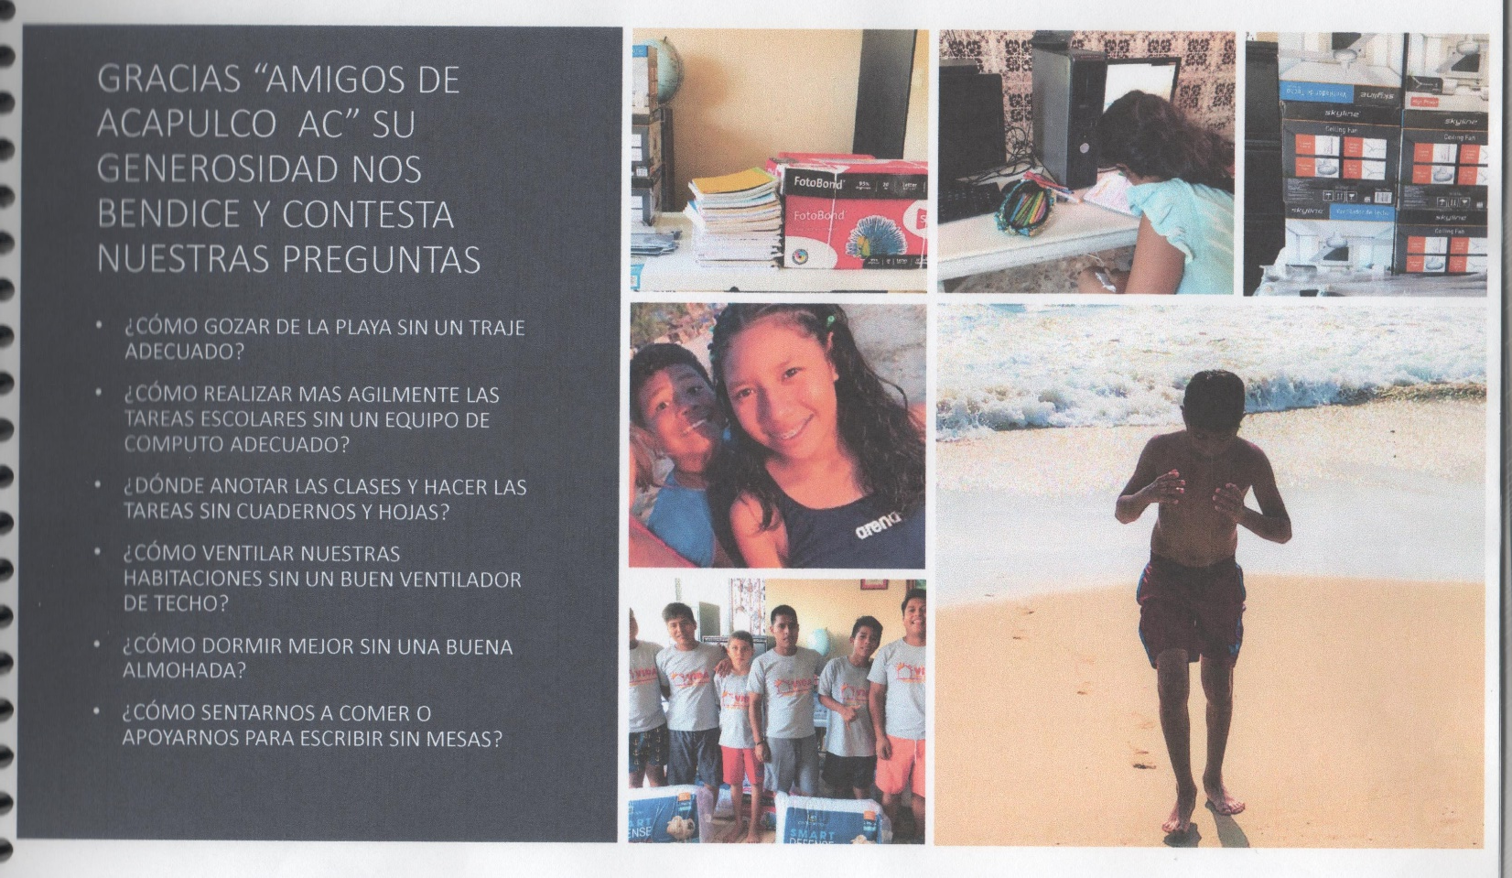

Slide 15
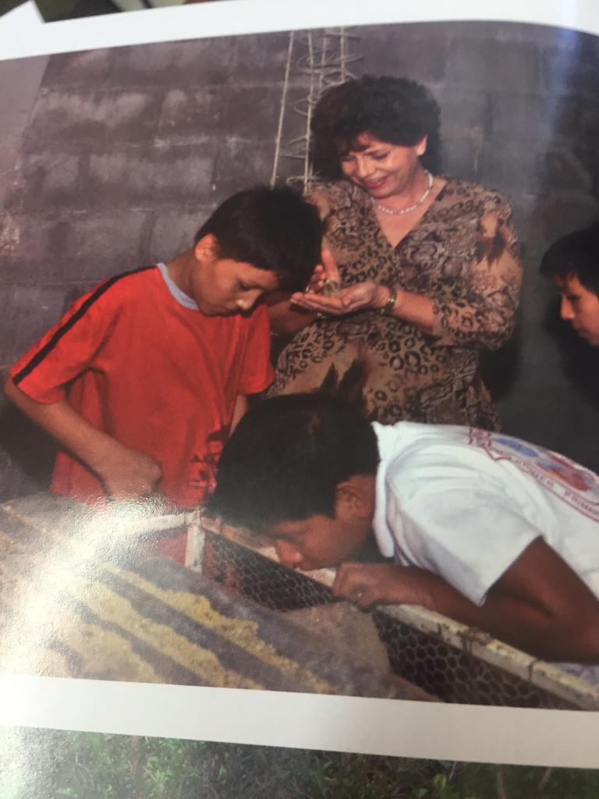

Slide 16
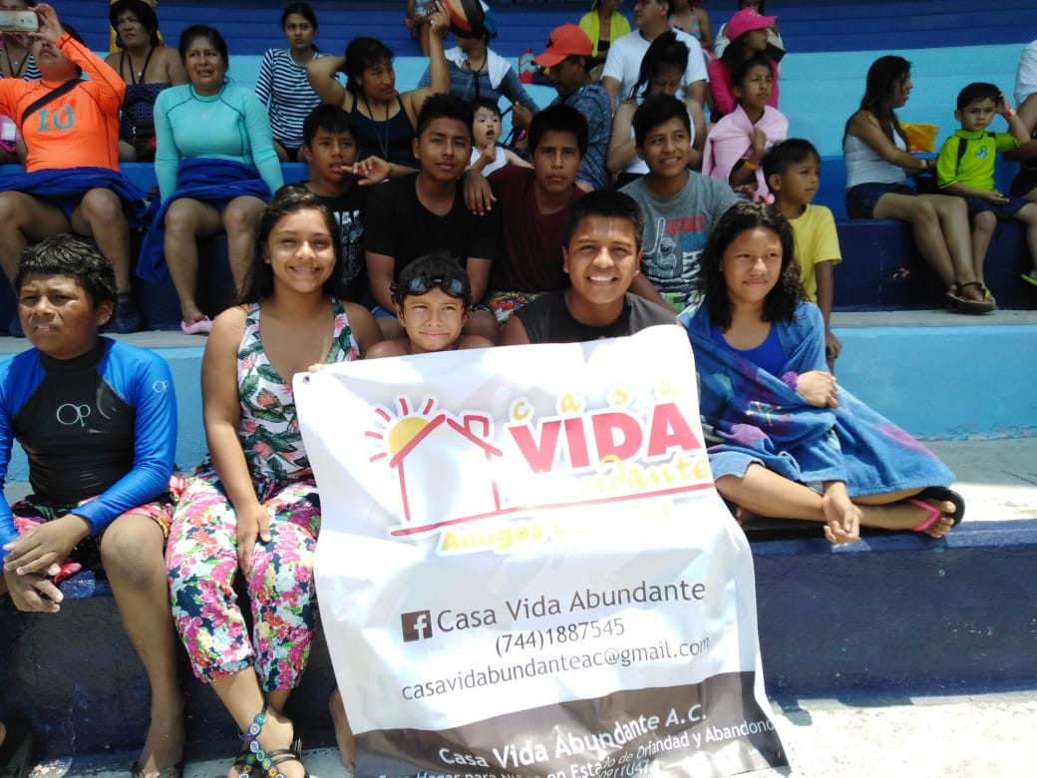
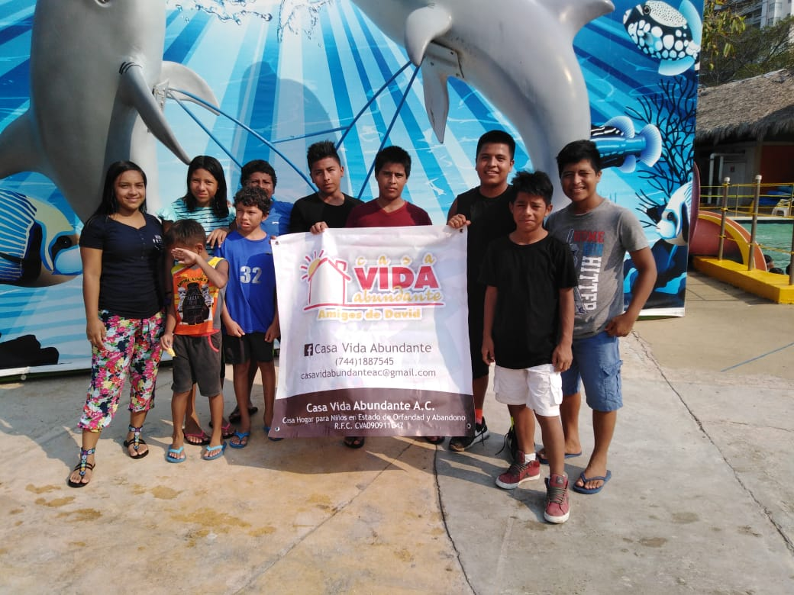
CHILDRENS ACTIVITIES

Slide 17
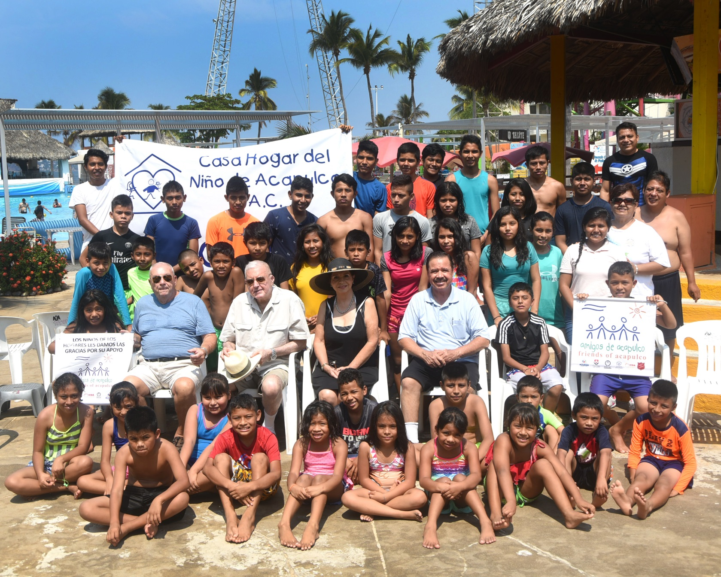
CHILDRENS ACTIVITIES

Slide 18
CHILDRENS ACTIVITIES

Slide 19
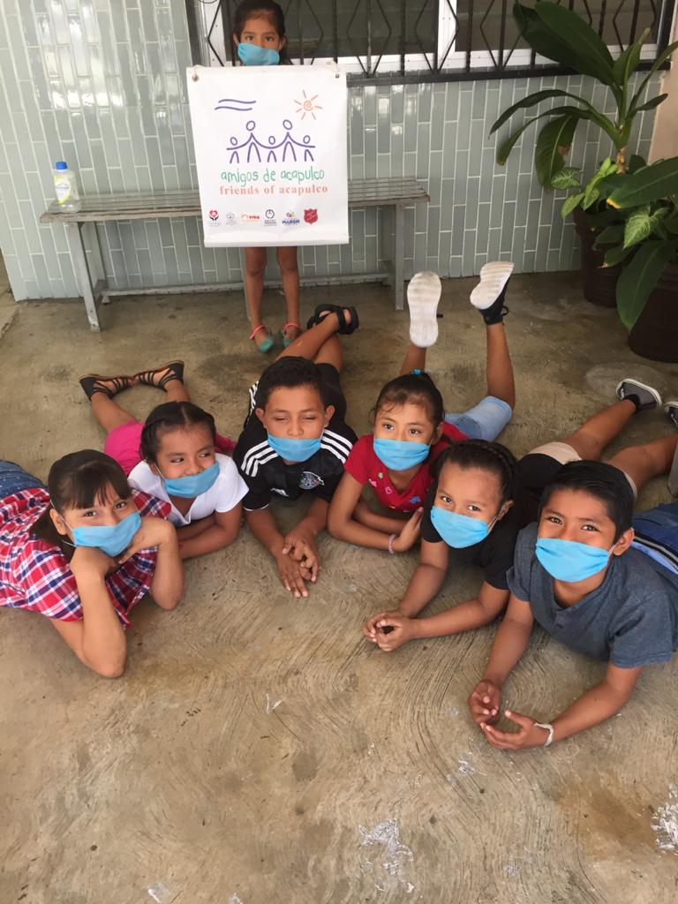
FREE MEDICAL SERVICE

Slide 20
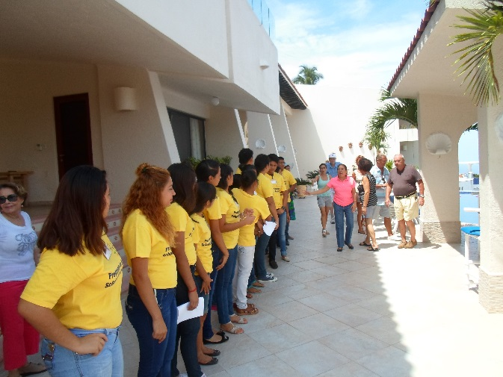
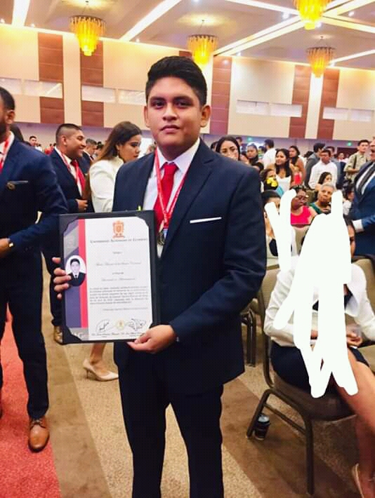
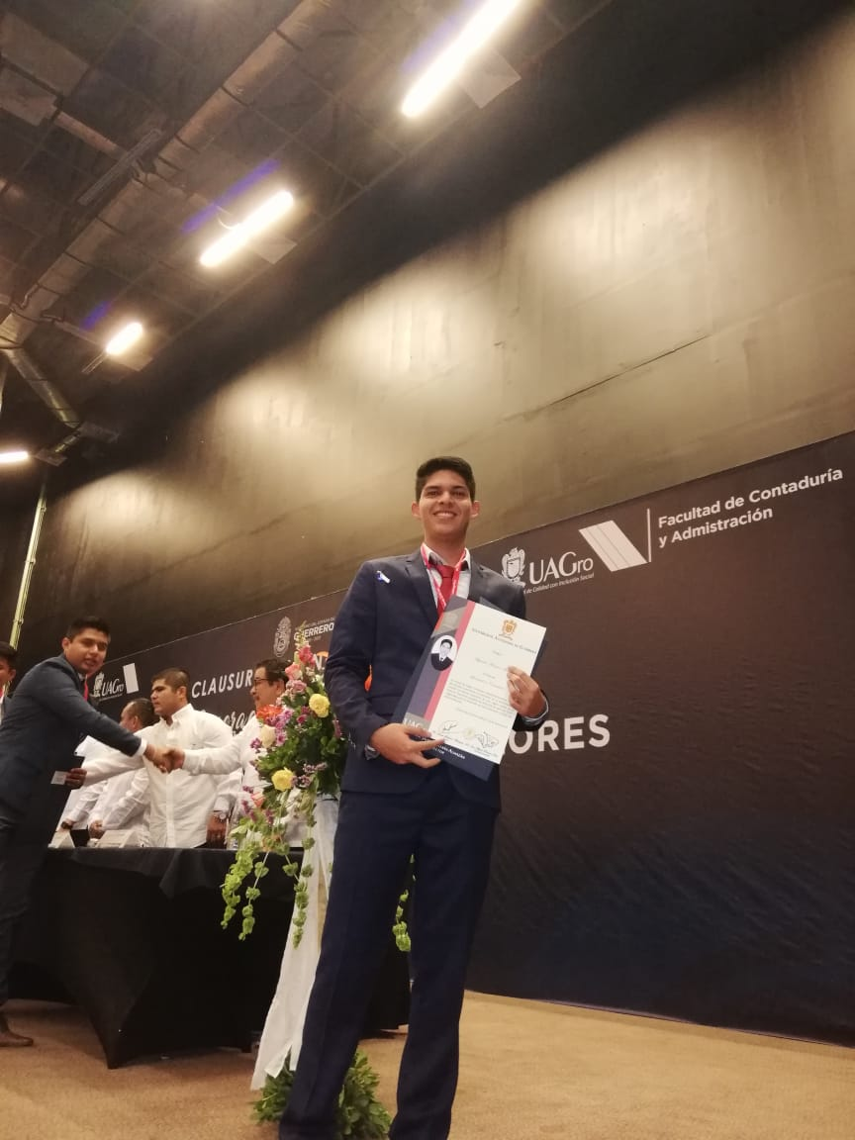
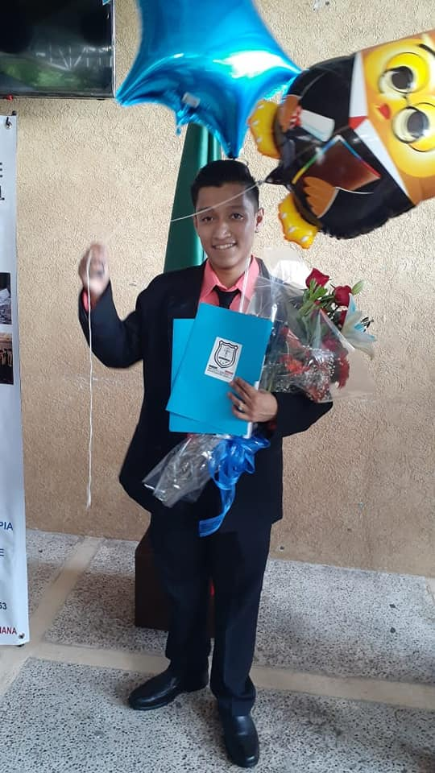
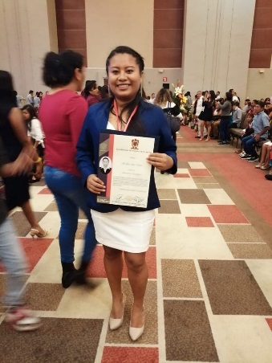
SCHOLAR SHIP

Slide 21
SPECIAL DONATIONS

Slide 22
SPECIAL DONATIONS

Slide 23
SPECIAL DONATIONS

Slide 24
SPECIAL DONATIONS

Slide 25
INVITACIONES GALA DINNER
GALA DINNER

Slide 26
GALA DINNER

Slide 27
PRESENTATION OF THE BOARD MEMBERS 2020-2022
9. PRESENTATION OF THE BOARD MEMBERS 2020-2022
OFFICERS: Catalina García President
Ron Lavender Honorary President
Marilú Baca 1st. Vice President
Donald Barth 2nd. Vice President
Alberto Rosas Treasurer
Directors: Nancy Barth
Marcela Pérez Romo de Morlett
Huguette Glushanok
David Grimes

Slide 29
GENERAL
AFFAIRS

Slide 30
CLOSE OF THE SESSION

Slide 31
COCKTAIL & HOR´S DEOUVRES

